Slide 1

Stage 2: EMBEDDING
Group: Amangel Bhullar, Divyam jain, Harshil tyagi

Slide 2
Project Summary
Goal: Fair quantitative comparison of embeddings on standard NLP tasks and datasets
Motivation: Different embeddings advantageous in different applications -- need for an objective evaluation performance metrics (in terms of accuracy, training time, etc.)
Tools: -
PyTorch (data pre-processing, batching of embeddings, MLP, Logistic Regression)
SentEval (dataset library for specific NLP tasks, e.g. sentiment analysis, question answering, language modeling, etc.)
Flair (library with pre-trained embeddings, e.g. Word2Vec, GloVe, BERT, etc.)
Hyperplot (optimization library for hyperparameter tuning, used for Sequential Bayesian Optimization) and implementation of Hyperplot extension
Conclusion: Transformer-based contextualized embeddings architectures (i.e., BERT) achieve state-of-the-art results and outperform static and other contextualized embeddings

Slide 3
Embedding models Analysed
Static Embeddings (MLP) → embed words
Word2Vec (Word to Vector)
GloVe (Global Vectors for Word Representation)
Contextualized Embeddings (Attention with LSTM or Transformers) → embed sentences
BERT (Bidirectional Encoder Representations from Transformers)
Notes:
WORD2VEC
A word embedding is a way of representing words as high-dimensional vectors.
These vectors capture the meaning of a word based on its context in a given text corpus.
The Word2Vec algorithm is a neural network model that learns word embeddings by predicting the context in which a word appears.
The model takes a large corpus of text as input and creates a vector representation for each word in the vocabulary.
The idea behind the model is that words that appear in similar contexts tend to have similar meanings.
In Python, we can use the Gensim library to create word embeddings using the Word2Vec algorithm.
GLOVE
it is a log-bilinear model with weighted least-squares and is based on the count of co-occurrence of words.
The glove model uses the matrix factorization technique for word embedding on the word-context matrix.
It starts working by building a large matrix which consists of the words co-occurrence .
The co-occurrence matrix tells us the information about the occurrence of the words in different pairs.
BERT
Vector encapsulate words and similar words closer to number.

Slide 4
SentEval, Flair and Hyperopt
SentEval - An Evaluation Toolkit for Universal Sentence Representations
A toolkit for evaluating the quality of universal sentence representations, but limited in generalization for different embeddings and new tasks with
standard datasets emerged from consensus in NLP community
standard architectures to evaluate the embeddings, yet with flexibility for fine-tuning
Flair - Contextual String Embeddings for Sequence Labeling
A library for pre-trained embeddings with a uniform API for easy access and use.
Hyperopt - A Python Library for Optimizing the Hyperparameters of ML Algorithms
sequential model-based optimization library for function minimization
Notes:
Sentval-toolkit

Slide 5
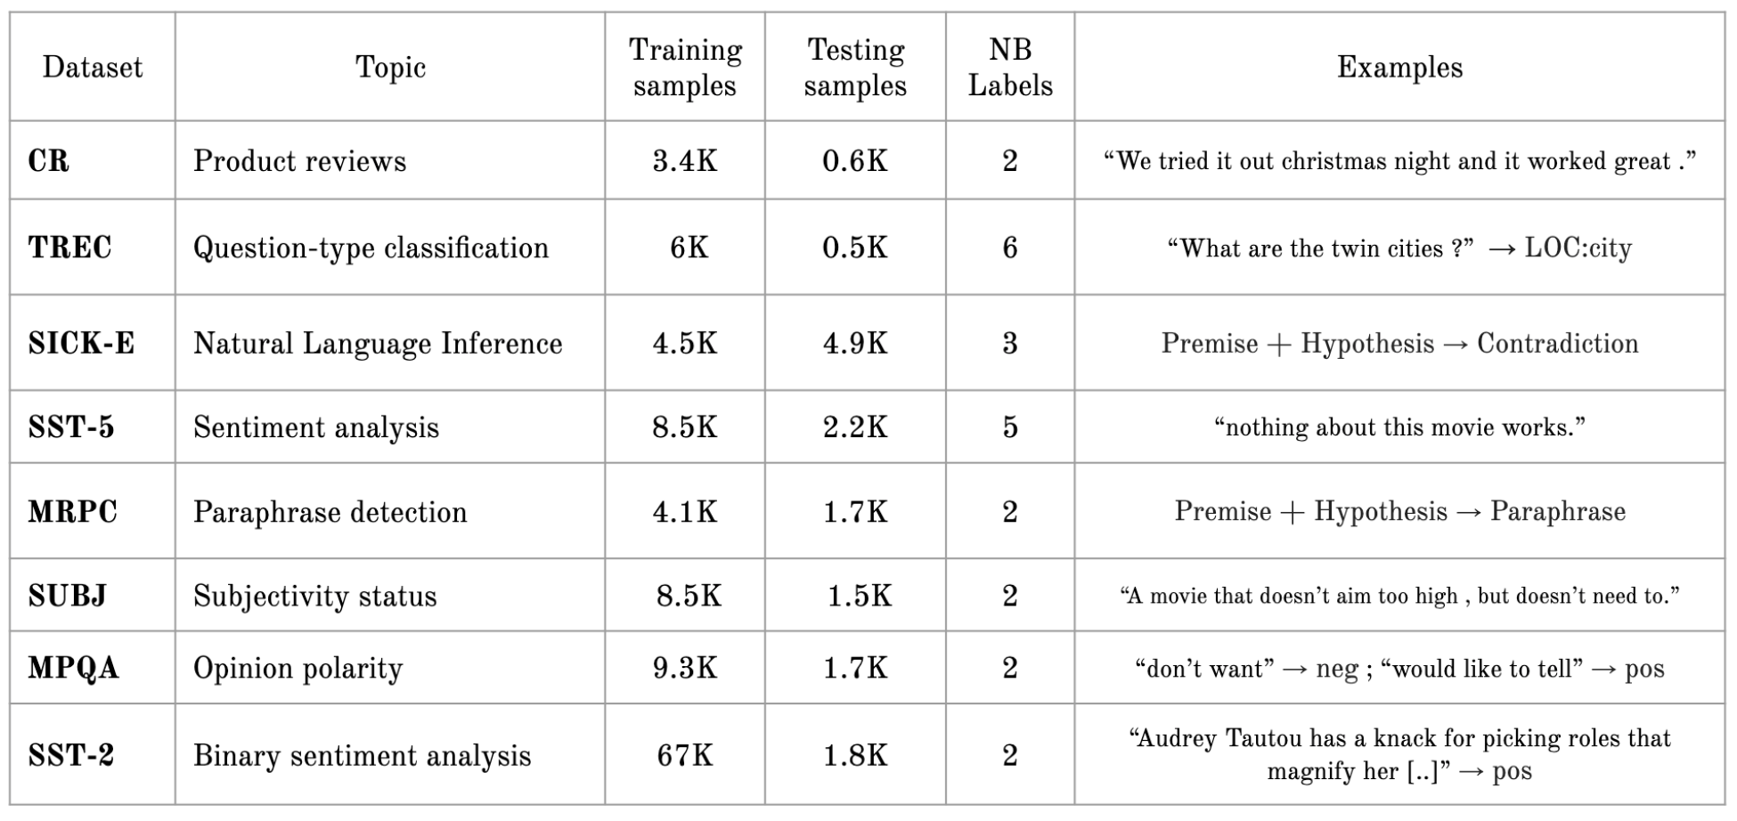
Downstream tasks with senteval

Slide 6
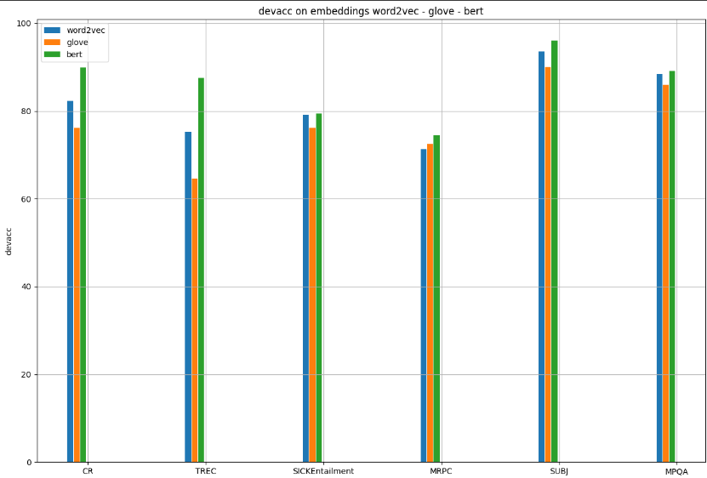
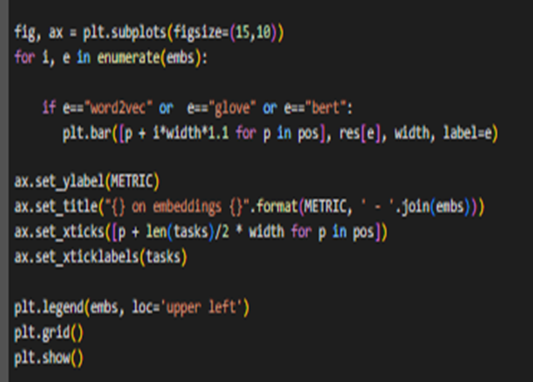
Devacc on embeddings: word2vec - glove - bert

Slide 7
Results: pre-processing time
Emb\Task | CR | TREC | SICK-E | SST-5 | MRPC | SUBJ | MPQA | SST-2
Word2vec | 2.1s | 2.2s | 6.7s | 7.2s | 7.5s | 7.2s | 1.8s | 24.5s
GloVe | 2.4s | 1.8s | 6.5s | 6.8s | 7.5s | 7.2s | 1.8s | 23.5s
BERT | 2m 19s | 3m 8s | 10m 6s | 7m 15s | 7m 26s | 6min 12s | 5min 12s | 37m 44s

Slide 8
Results: training time
Emb\Task | CR | TREC | SICK-E | SST-5 | MRPC | SUBJ | MPQA | SST-2
Word2vec | 10m 48s | 31m 48s | 25m 49s | 43m 59s | 18m 49s | 42m 15s | 33m 22s | 7h 46m
GloVe | 9m 58s | 25m 23s | 21m 32s | 30m 4s | 12.43s | 29m 19s | 18m 13s | 6h 12s
BERT | 14m 12s | 27m 16s | 37m 11s | 1h 19s | 25m 48s | 31m 59s | 28m 44s | 8h 46s

Slide 9
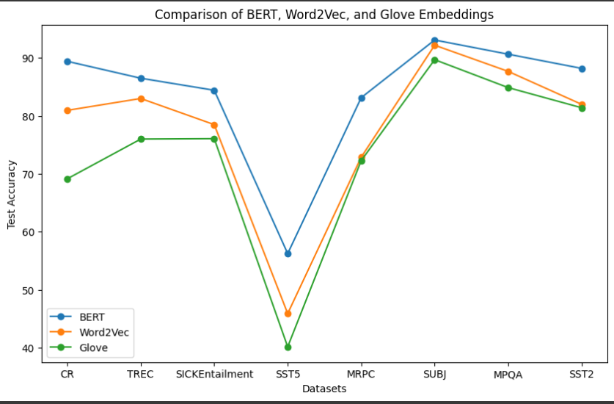
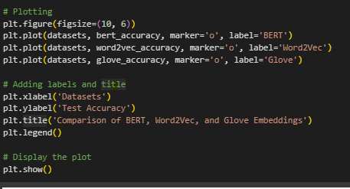
RESULTS BASED ON DATASETS:

Slide 10
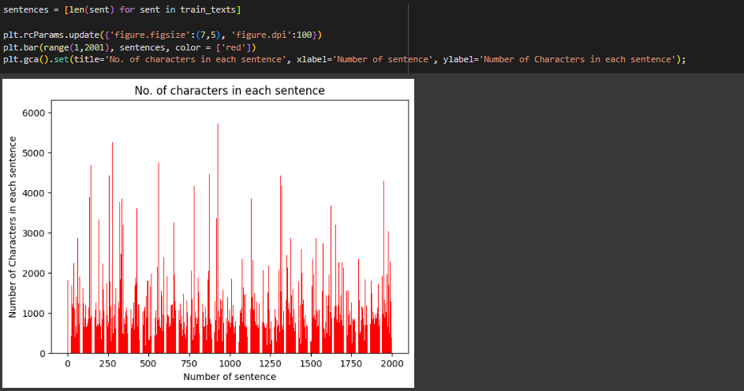
Classification on BERT USING IMBDB DATAset

Slide 11
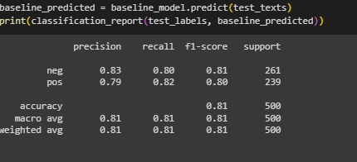
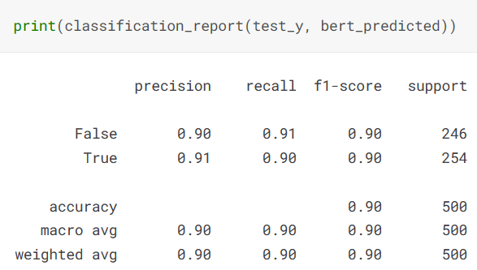
P-R Values Before and after fine tunning
Prediction before fine tuning
Prediction after Fine tuning

Slide 12
THAnkyou

